Slide 1
Computer Programming Basics
Jeon, Seokhee
Assistant Professor
Department of Computer Engineering,
Kyung Hee University, Korea

Slide 2
LECTURE 2

Slide 3
Review
“A computer is a general purpose device that can be programmed to carry out a finite set of arithmetic or logical operations.”
Device? Hardware!
Programmed? Software!
Arithmetic or logical? Digital!

Slide 4
A BIT MORE ABOUT COMPUTER
- HOW A COMPUTER WORKS
FROM “BIT” TO “PROGRAM”

Slide 5
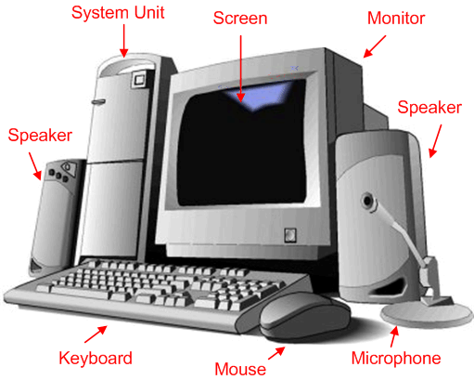
Typical Personal Computer Hardware
System Unit
CPU
Main memory
Disks
Output devices
Input devices

Slide 6
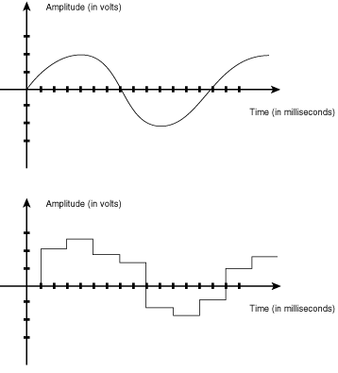
Digital and Analogue

Slide 7
Why Digital?
Digital is simple! → Every signal can be expressed by a limited number of digits (numbers). (analogue is not)
Digital is efficient! → Digits can be easily stored, transmitted, and copied.

Slide 8
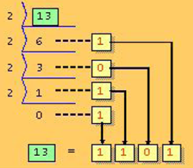
Binary
For computers, binary is the most efficient way to express numbers because
  Binary → 0 and 1 → 0 volt and 5 volt
Converting decimal to binary

Slide 9
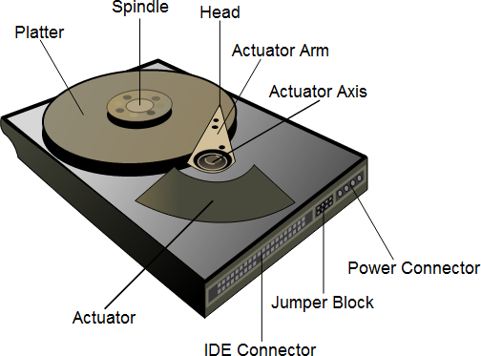
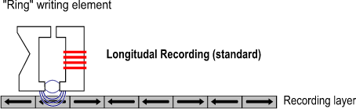
How Binary Is Actually Stored
Hard disk

Slide 10
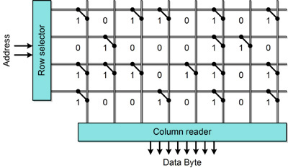
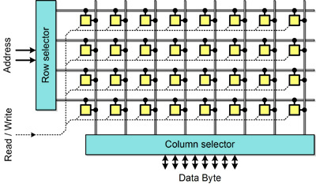
How Binary is Actually Stored
ROM (Read only memory)
RAM (Random access memory)

Slide 11
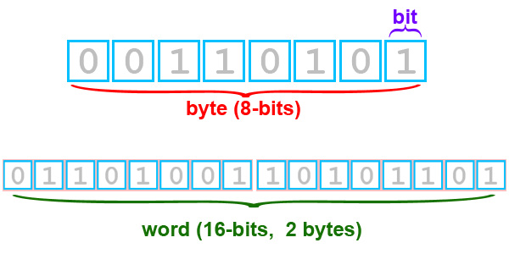
Bit and Byte
Number of Bits | Name | Number of Bytes | Range
8 | Byte | 1 | 0 to 255 (unsigned)
16 or 32 depending on machine | Word | 2 or 4 | 0 to 65,535 (unsigned) or 0 to 2³² − 1 (unsigned)

Slide 12
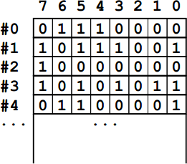
Management of Memory
Byte
Memory address

Slide 13
Bit can Represent Everything
Character
  Encoding: character-bit pattern pairs
  E.g., ‘a’ ➔ 01100001, ‘D’ → 01000100
Color of a pixel
  Combination of Red-Green-Blue. Each component has 8-bit-depth intensity
  e.g., white → R:11111111 G:11111111 B: 11111111. Yellow → R:11111111 G:11111111 B:00000000
Sound
  Sampling and discretizing sound wave form

Slide 14
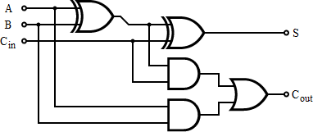
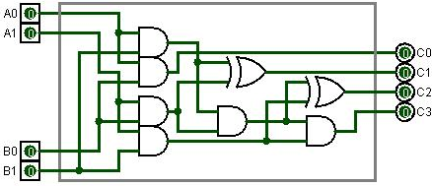
Binary Operations in CPU
Inputs |  |  | Outputs
A | B | C_{in} | C_{out} | S
0 | 0 | 0 | 0 | 0
1 | 0 | 0 | 0 | 1
0 | 1 | 0 | 0 | 1
1 | 1 | 0 | 1 | 0
0 | 0 | 1 | 0 | 1
1 | 0 | 1 | 1 | 0
0 | 1 | 1 | 1 | 0
1 | 1 | 1 | 1 | 1
Adding A and B
Multiplying A0A1 and B0B1

Slide 15
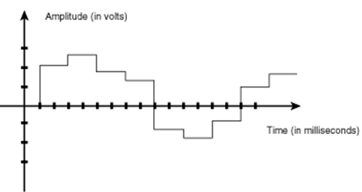
All Connected
Digital data
Store in hard disk
Loaded in memory
Operated in CPU

Slide 16
What Programs Do
Digital data
Store in hard disk
Loaded in memory
Operated in CPU

Slide 17
Review
Digital → limited amount of numbers
Numbers → treated as binary in computers
Binary → bit and byte
Byte → a basic unit in memory
CPU → does binary operations
The flow of bit → hard disk -> memory -> CPU
Program → managing the flow of bit

Slide 18
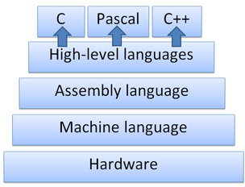
Review of Programming Language Hierarchy

Slide 19
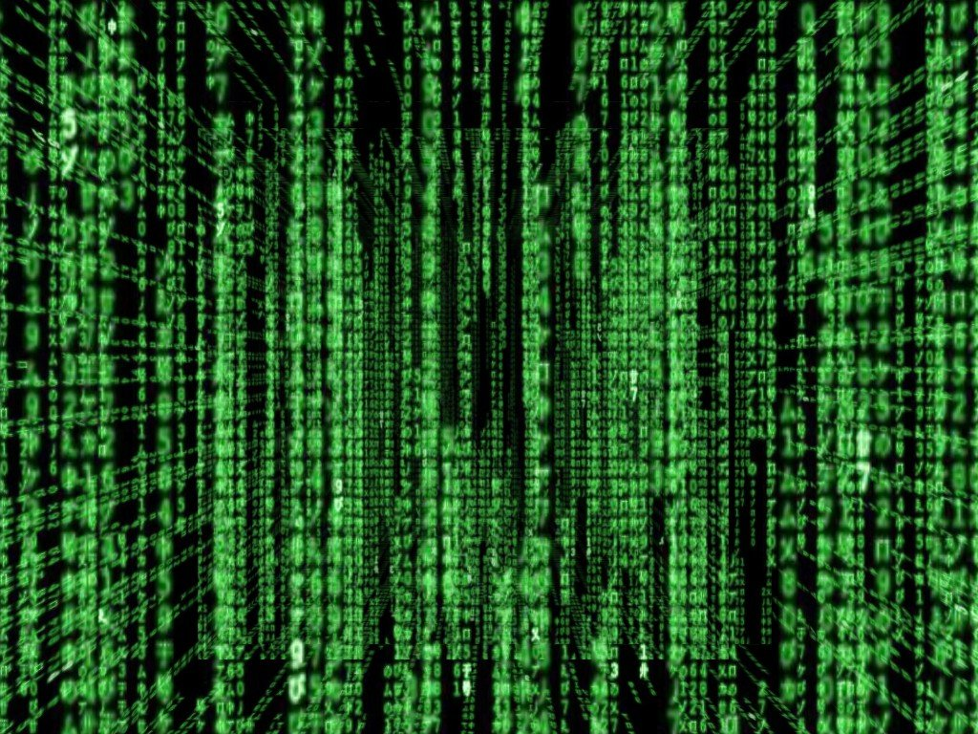
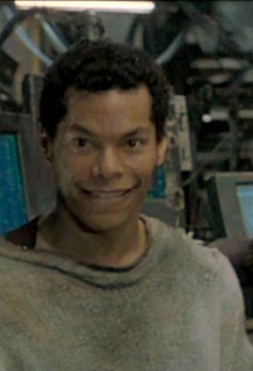
Hierarchy of Programming Language
The movie “Matrix”
Can’t you see? Neo is here.

Slide 20
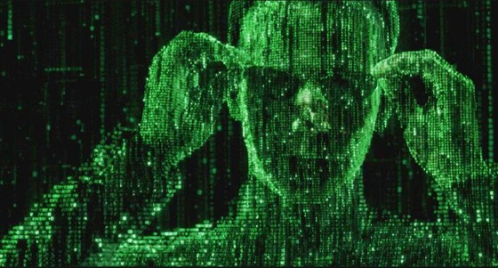
Hierarchy of Programming Language
The movie “Matrix”
Now you can pick Neo, but not clearly.

Slide 21
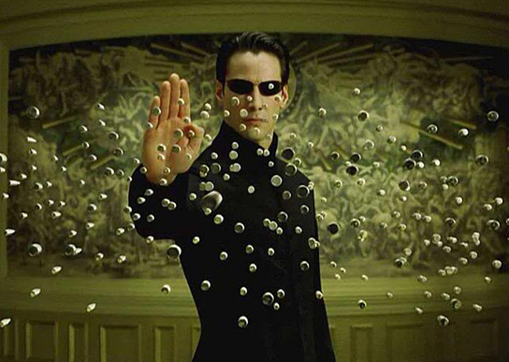
Hierarchy of Programming Language
The movie “Matrix”

Slide 22
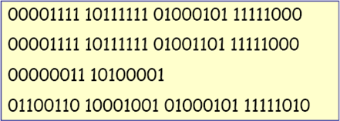
Why We Need High-Level Language
Machine language: A binary-based language that a machine can understand
  Not human friendly
  Hardware dependent

Slide 23
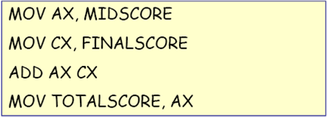
Why We Need High-Level Language
Assembly language: a one–to–one correspondence from a binary machine instruction to a more human-friendly mnemonics.
  Still quite hard for human programmers to develop big, structured program.
  Still hardware dependent

Slide 24
Why We Need High-Level Language
High level language
  Getting away from hardware → one code can be used for many different computers
  Strong abstraction from the details of the computer → higher programming efficiency
  Natural language element → easier to understand

Slide 25
SOLVING PROBLEMS USING COMPUTER

Slide 26
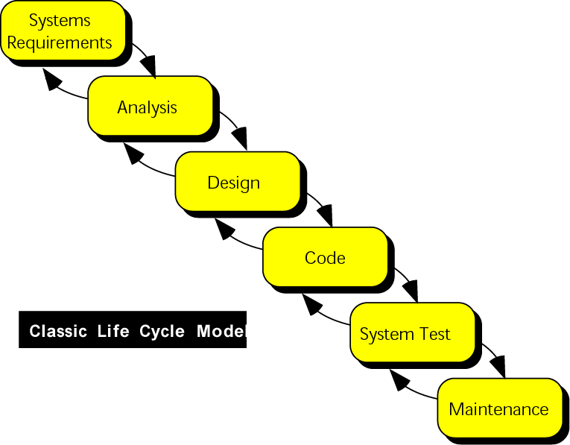
System Development

Slide 27
Program Development Process
  Understand the problem
  Develop a solution
  Write a program
  Test the program

Slide 28
1. Understand the Problem
Calculate the square meters of your house.
What is the definition of square meter?
How is the square meter going to be used?
-for insurance purposes?
to paint ?
…
Is the garage included?
…

Slide 29
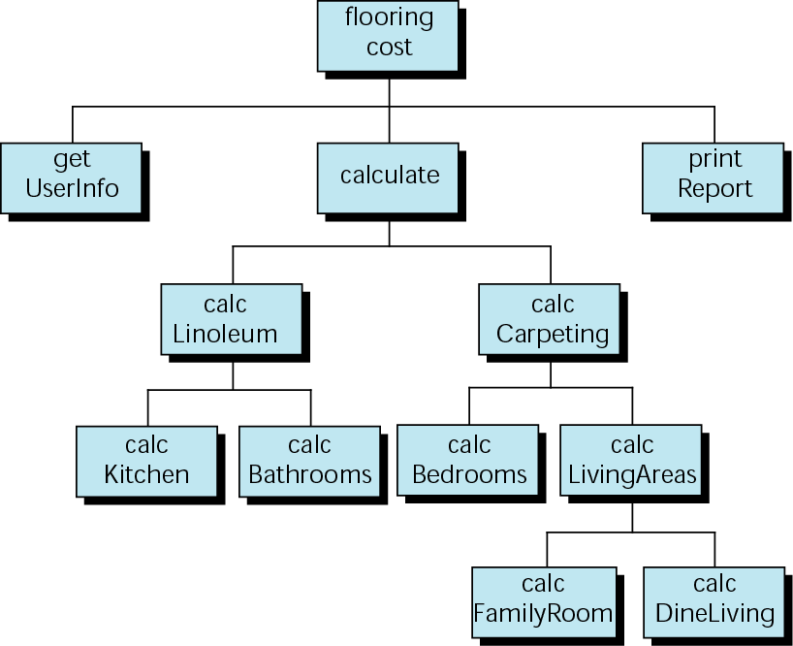
2. Develop a Solution
Structure chart
  Hierarchy chart
  Each step will be a separate module.

Slide 30
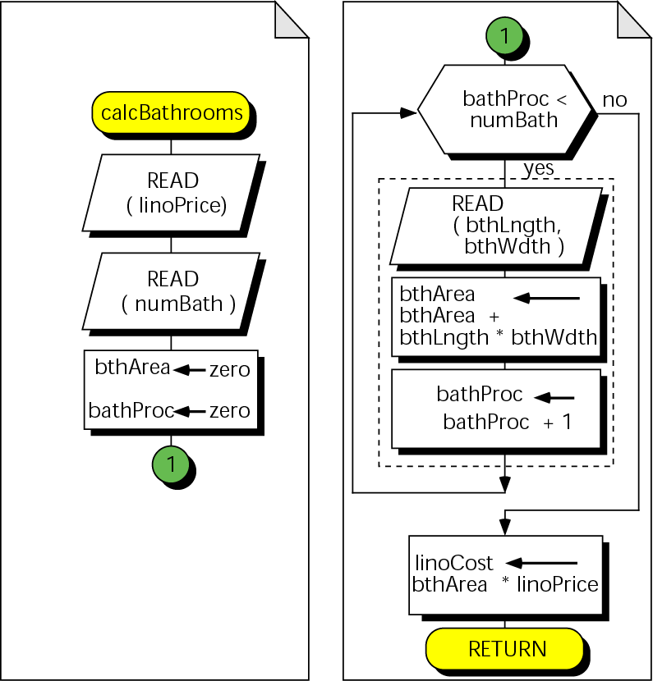
2. Develop a Solution
Pseudocode
  A precise algorithmic
  description of program logic
Flowchart
  Graphical version of pseudocode
Algorithm Calculate Bathrooms
1 prompt user and read linoleum price
2 prompt user and read number of bathrooms
3 set total bath areas and baths processed to zero
4 while ( baths processed < number of bathrooms)
1 prompt user and read bath length and width
2 total bath area =
3 total bath area + bath length * bath width
4 add 1 to baths processed
5 end while
6 bath cost = total bath area * linoleum price
7 return bath cost
8 end Algorithm Calculate Bathrooms

Slide 31
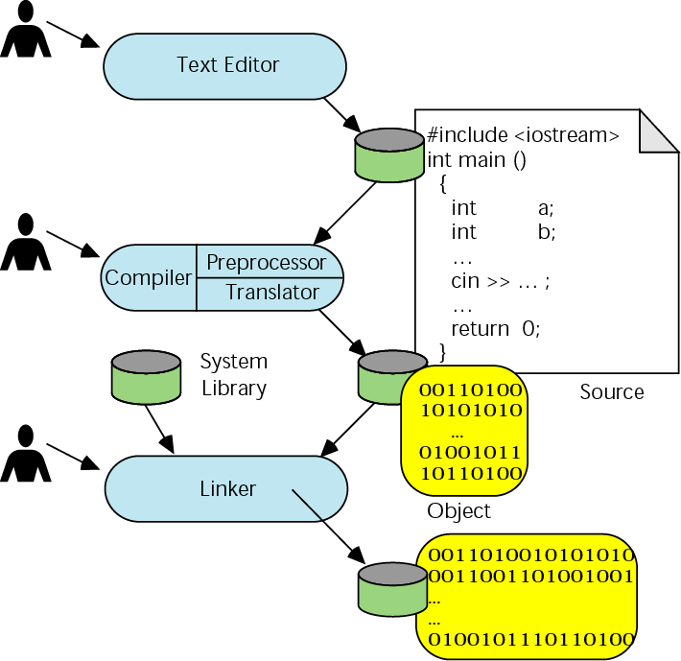
3. Write a Program
Writing and editing programs
  Text editor
  Source file
Compiling programs
  Compiler:
  preprocessor/translator
Linking programs
  The linker assembles
  all of functions
  (source and system’s)
  into final executable
  program.
<number>/37

Slide 32
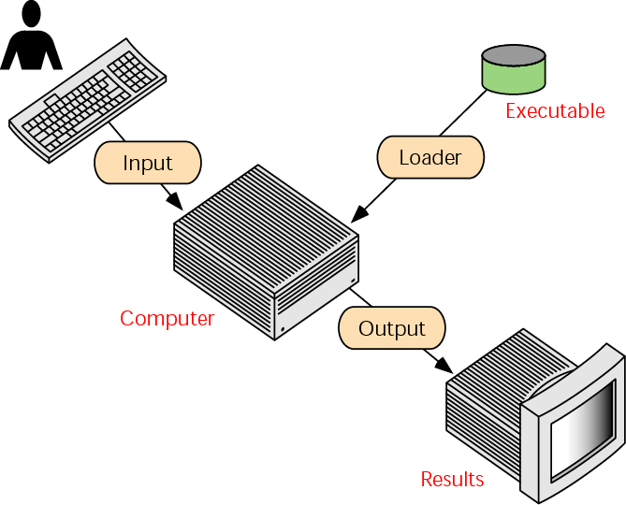
3. Writing a Program (Executing)
Getting the program into memory is the function of an operating system (OS) program known as the loader.

Slide 33
4. Test the Program
Specification errors
  When the problem definition is either incorrectly stated or misinterpreted.
  They should be caught during blackbox testing.
Code errors
  Compiler error message
Logic errors
  They can be corrected only by thorough whitebox testing.

